Slide 1
How do students learn?
Part 1
Why is memory so important in learning?

Slide 2
Defined as
a change in
Knowledge Skills & Attitudes
Observable as
New Behaviours
Learning
Stored in
Long-term Memory

Slide 3
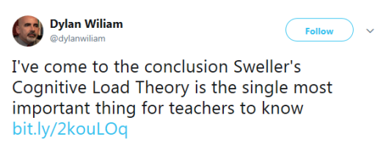
Professor of Educational Assessment
https://twitter.com/dylanwiliam/status/824682504602943489

Slide 4
“The most important single factor influencing learning is what the learner already knows”
John Hattie and Gregory Yates
Hattie, John, and Gregory CR Yates. Visible learning and the science of how we learn. Routledge, 2013.

Slide 5
Defined as
a change in
Knowledge Skills & Attitudes
Observable as
New Behaviours
Learning
Stored in
Long-term Memory

Slide 6
One part of
Teaching
Lecturing
Facilitates
Defined as
a change in
Knowledge Skills & Attitudes
Observable as
New Behaviours
Learning
Stored in
Long-term Memory

Slide 7
How do students learn?
Part 2
What are the main parts of human memory?

Slide 8
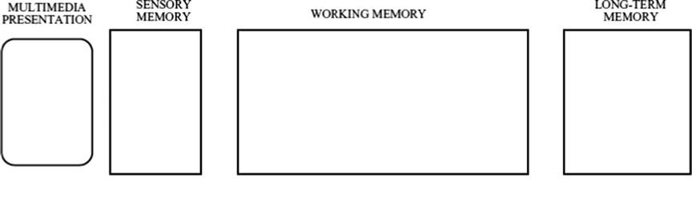


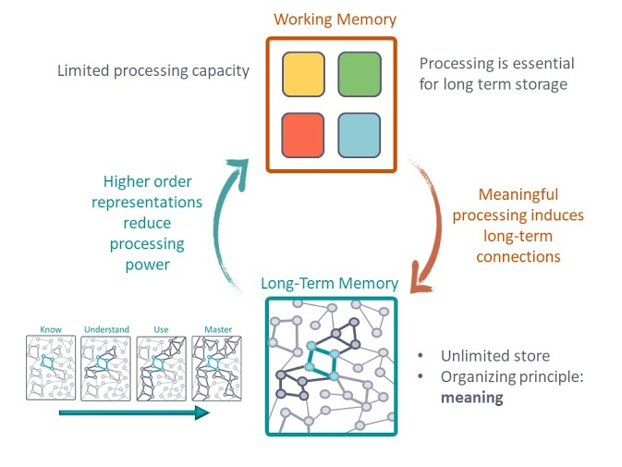




How memory works
Image source: https://sites.google.com/view/efratfurst/learning-in-the-brain and Dkahng / CC-BY-SA-4.0

Slide 9
Chunks
67
67
5385
53, 85
5558
555, 8

Slide 10
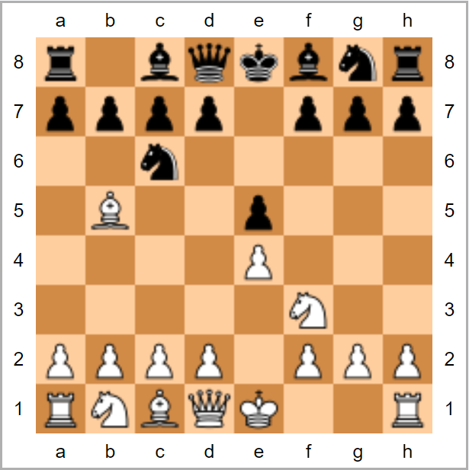
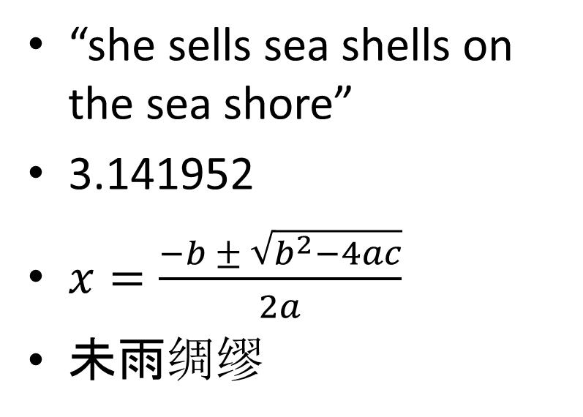
Memory Test
“she sells sea shells on the sea shore”
3.141952
$x=\frac{−b ± \sqrt{b^{2}−4ac}}{2a}$
未雨绸缪

Slide 12
“The most important single factor influencing learning is what the learner already knows”
John Hattie and Gregory Yates
Hattie, John, and Gregory CR Yates. Visible learning and the science of how we learn. Routledge, 2013.

Slide 13
Memory Test
“she sells sea shells on the sea shore”
3.141952
$x=\frac{−b ± \sqrt{b^{2}−4ac}}{2a}$
未雨绸缪

Slide 14
How memory works
Image source: https://sites.google.com/view/efratfurst/learning-in-the-brain and Dkahng / CC-BY-SA-4.0

Slide 15
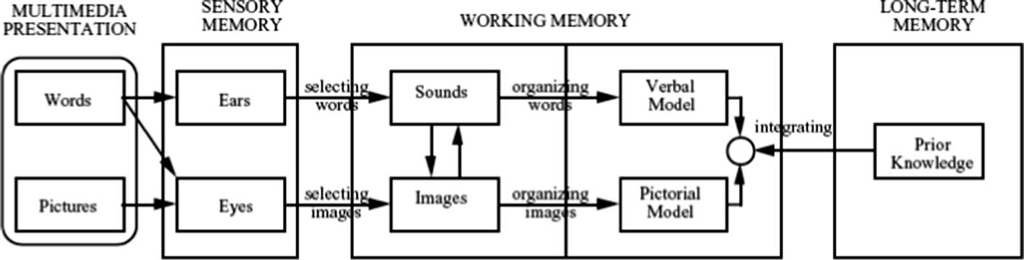




Dual coding theory
Prior Knowledge
Image source: https://sites.google.com/view/efratfurst/learning-in-the-brain and Dkahng / CC-BY-SA-4.0

Slide 16
How do students learn?
Part 3
What is the process of storing and retrieving memories?

Slide 17
Defined as
a change in
Knowledge Skills & Attitudes
Observable as
New Behaviours
Learning
Stored in
Memory
Prior Knowledge
Image source: https://sites.google.com/view/efratfurst/learning-in-the-brain and Dkahng / CC-BY-SA-4.0

Slide 18
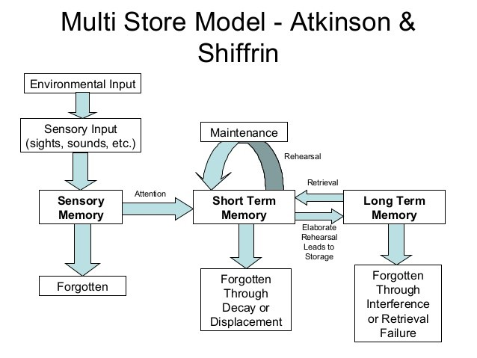
Remembering
Image source: Dkahng / CC-BY-SA-4.0

Slide 19
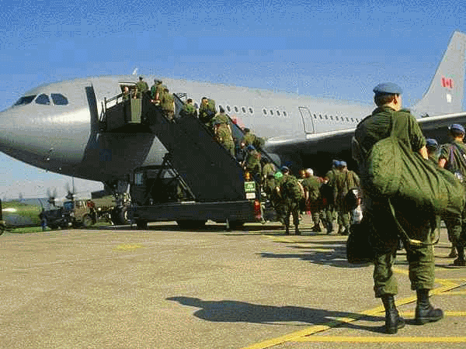
Change Blindness the importance of attention
http://csc.ncsu.edu

Slide 20
Change Blindness the importance of attention
https://www.youtube.com/watch?v=vJG698U2Mvo
https://www.youtube.com/watch?v=v3iPrBrGSJM
Simons, Daniel J., and Michael S. Ambinder. "Change blindness: Theory and consequences." Current directions in psychological science 14.1 (2005): 44-48.

Slide 21
Remembering
Image source: Dkahng / CC-BY-SA-4.0

Slide 22
Interference
English | French
Water | Eau
Good | Bon
Milk | Lait
Fish | Poisson
English | Italian
Water | Acqua
Good | Buono
Milk | Latte
Fish | Pesce

Slide 23
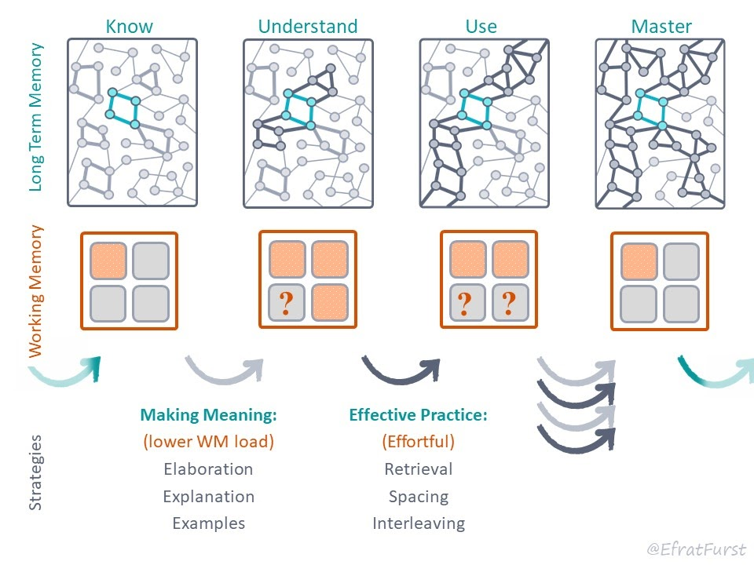
Retrieving long term memories
https://sites.google.com/view/efratfurst/learning-in-the-brain

Slide 24
“Memory is the residue of thought”
Daniel T. Willingham
Professor of Psychology
Willingham, Daniel T. "What will improve a student’s memory." American Educator 32.4 (2008): 17-25.

Slide 25
Storing long term memories
https://sites.google.com/view/efratfurst/learning-in-the-brain

Slide 26
Metacognitive Questions
Why is this fact true?
In which situations can I imagine using this knowledge?
How is this similar to what I already know?

Slide 27
Remembering
Image source: Dkahng / CC-BY-SA-4.0

Slide 28
The importance of context
“The procedure is actually quite simple. First you arrange things into different groups. Of course, one pile may be sufficient depending on how much there is to do. If you have to go somewhere else due to lack of facilities that is the next step, otherwise you are pretty well set. It is important not to overdo things. That is, it is better to do too few things at once than too many. In the short run this may not seem important but complications can easily arise. A mistake can be expensive as well. At first the whole procedure will seem complicated. Soon, however, it will become just another facet of life. It is difficult to foresee any end to the necessity for this task in the immediate future, but then one never can tell, After the procedure is completed one arranges the materials into different groups again. Then they can be put into their appropriate places. Eventually they will be used once more and the whole cycle will then have to be repeated. However, that is part of life”
Bransford, John D., and Marcia K. Johnson. "Contextual prerequisites for understanding: Some investigations of comprehension and recall." Journal of verbal learning and verbal behavior 11.6 (1972): 717-726.

Slide 29
Memory Test
EFA TOW LAT EHI SHA TTE

Slide 30
Memory Test
The importance of structure
EFA TOW LAT EHI SHA TTH
THE FAT OWL ATE HIS HAT

Slide 31
The importance of structure
List the months of the year
in alphabetical order

Slide 32
How do students learn?
Part 4
How does knowing facts lead to understanding?

Slide 33
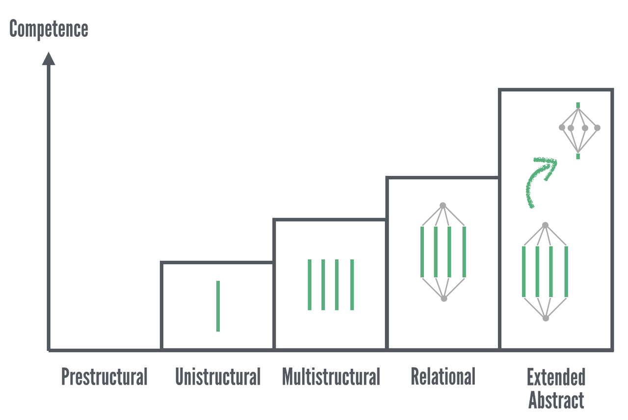
SOLO Taxonomy
Image source: Doug Belshaw / CC-0-1.0

Slide 34
SOLO Taxonomy
Mental Models
Facts, Ideas
Schemata
Image source: https://sites.google.com/view/efratfurst/learning-in-the-brain and Doug Belshaw / CC-0-1.0

Slide 35
How do students learn?
Part 5
What determines our speed of learning?

Slide 36
“Memory is the residue of thought”
Daniel T. Willingham
Professor of Psychology
Willingham, Daniel T. "What will improve a student’s memory." American Educator 32.4 (2008): 17-25.

Slide 37
Which are “active learning”?
Sitting in lecture
Taking notes in a lecture
Group work
Solving question sheets
Group discussion

Slide 38

Learning speed
×
×
time
focus
prior
knowledge

Slide 39
Learning speed
conscientiousness
×
×
time
focus
prior
knowledge
IQ

Slide 40
Learning speed
motivation
×
×
time
focus
prior
knowledge
sequence
prime
distractions,
scaffolding

Slide 41
How do students learn?
Part 6
What is Cognitive Load theory?

Slide 42
Professor of Educational Assessment
https://twitter.com/dylanwiliam/status/824682504602943489

Slide 43

Cognitive load theory
Complexity of the activity
×
×
Elements unrelated to the problem
Complexity of the instruction

Slide 44
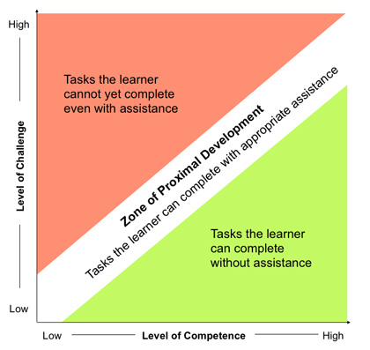
Zone of Proximal Development
×
Complexity of the activity
Prior knowledge
Image source: Awan, et al. "Making learning fun: gaming in radiology education." (2019)

Slide 45
How to experience cognitive overload
1, 9, 5

Slide 46
How do students learn?
Part 7
What effects our motivation?

Slide 47
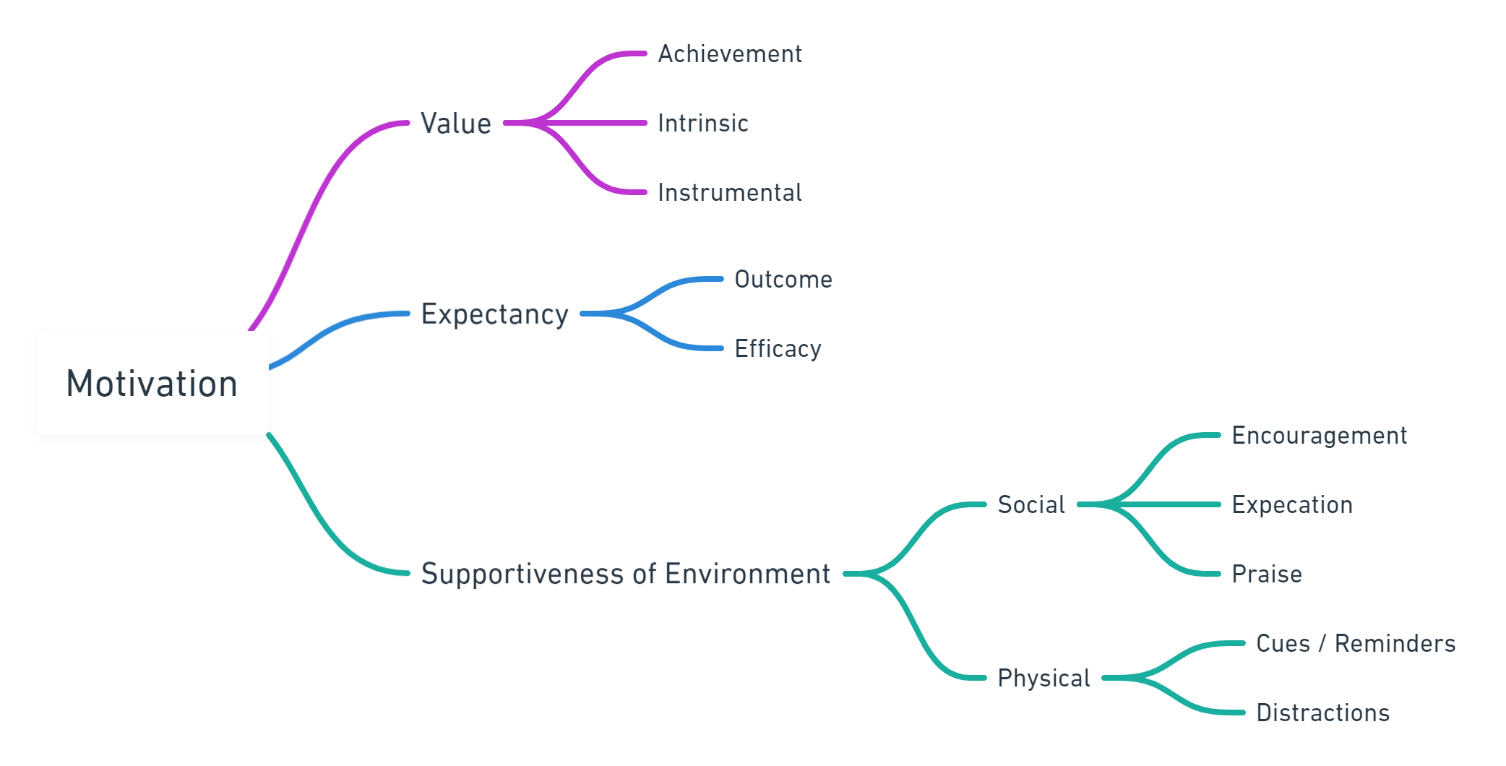

Slide 48
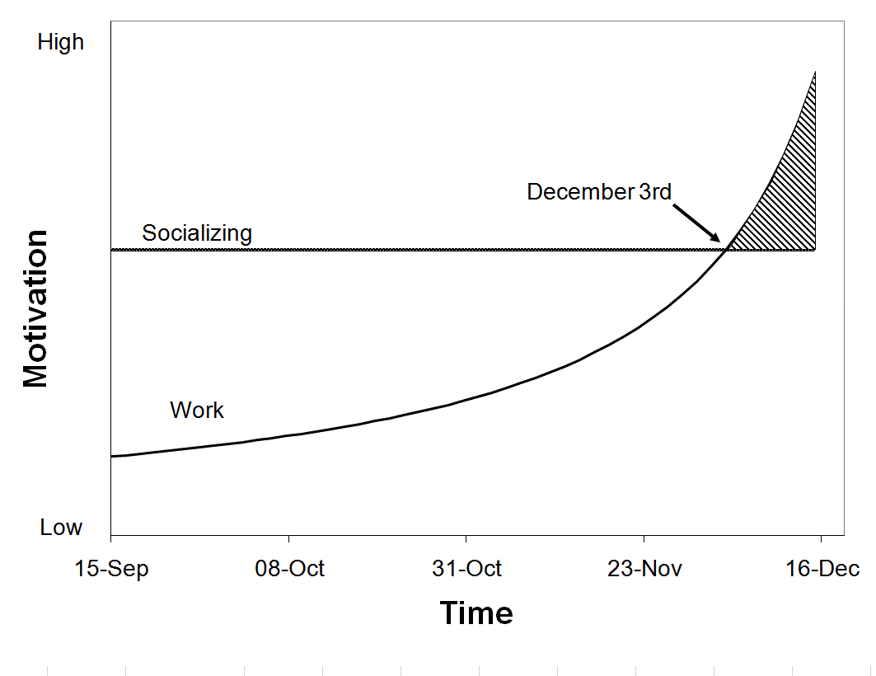
https://procrastinus.com/piers-steel/theories-of-procrastination/

Slide 49
How do students learn?
Part 8
Summary

Slide 50
Questions
Why is memory so important in learning?
What are the main parts of human memory?
What is the process (and errors) of storing and retrieving memories?
How does knowing facts lead to understanding?
What determines our speed of learning?
What is Cognitive Load theory?
What effects our motivation?

Slide 51


Defined as
a change in
Knowledge Skills & Attitudes
Observable as
New Behaviours
Learning
Stored in
Memory
Mental
Models
Understanding,
Schemata
Facts, Ideas

Slide 52

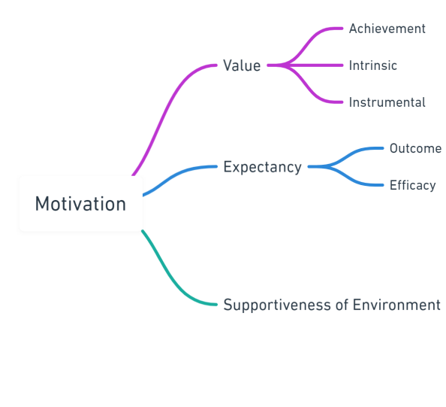
×
×
time
focus
prior
knowledge

Slide 53
Activity 1
Explain ‘how students learn’

Slide 54
Activity 2
Evaluate your course material against how students learn

